Slide 1
High-Dimensional Filtering
20163641 Dongho Choi

Slide 2
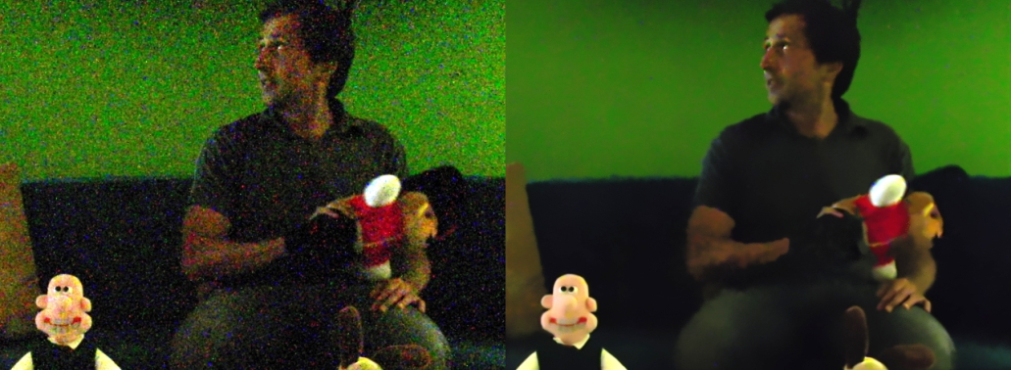
Filtering
[Images from the paper]

Slide 3
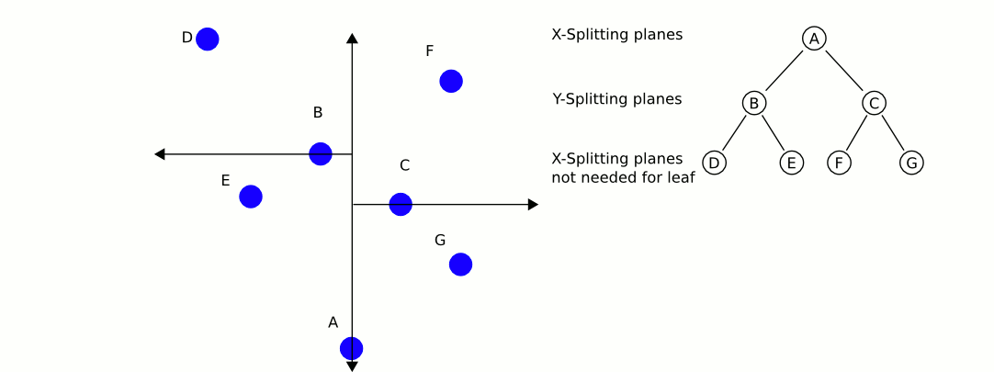
KD-tree

Slide 4
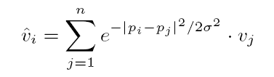

Gaussian and Bilateral Filtering
Space Weight
Range Weight

Slide 5
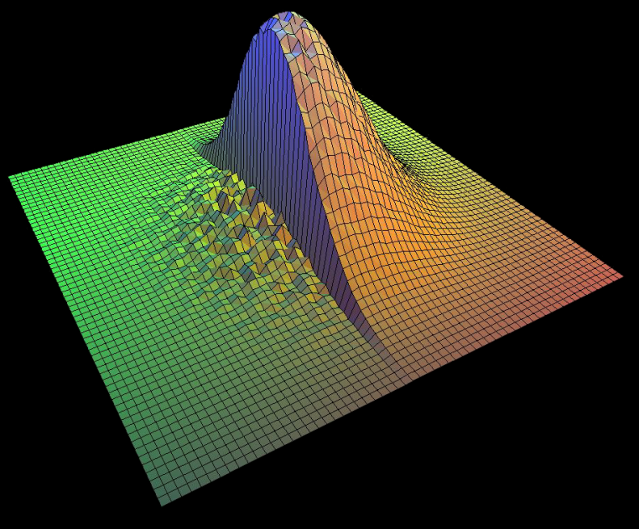
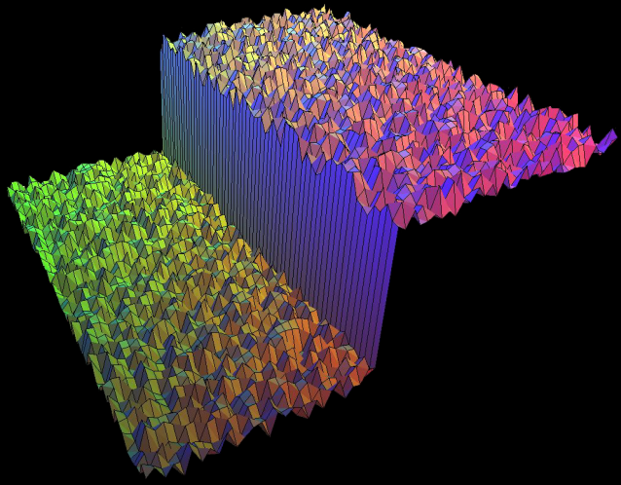
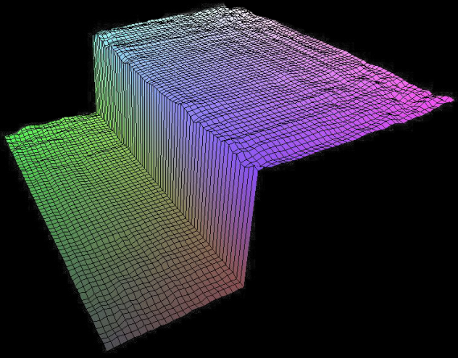
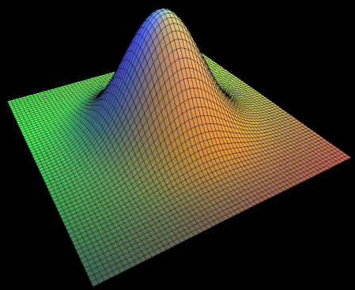
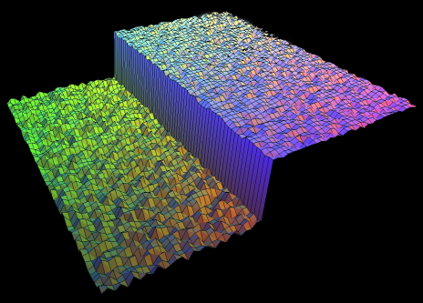
Gaussian and Bilateral Filtering
Intensity
[Images from the author’s slide]
y
x
Space Weight
Range Weight
Input
Bilateral Weight
Output

Slide 6
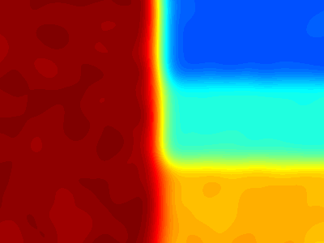
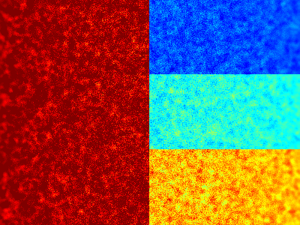
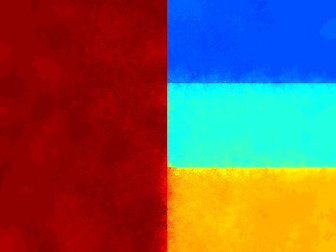
Gaussian and Bilateral Filtering
[Images from the author’s slide]
Gaussian: σ_{p} = 12
Input Image
Bilateral: σ_{p} = 12, σ_{c} = 0.15
Notes:
Bilateral: σ_{p} = 12, σ_{c} = 0.15 Gaussian: σ_{p} = 12

Slide 7
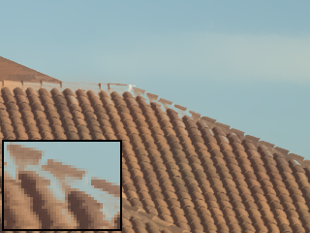
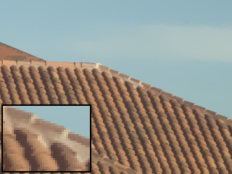
Gaussian and Bilateral Filtering
[Images from the paper]
Bilateral Filtering Based on Luminance
Bilateral Filtering Based on Color
High dimension!

Slide 8
Problem
High computational complexity
  O(n²d)
    Image size: n
    Dimension: d
  Powerful, but very slow
Accelerating method(downsampling) requires large space complexity
  Memory complexity: Exponential to the dimension d
  As does the time

Slide 9
Gaussian KD-Tree for
Fast High-Dimensional Filtering
A. Adams, N. Gelfand, J. Dolson, and M. Levoy

Slide 10
Gaussian KD-Tree
[Images from the author’s slide]

Slide 11
Building The Tree
Intensity
Longest Dimension, η¹_{d}
Gaussian KD-Tree
η¹
η¹_{cut}
η¹_{min}
η¹_{max}
Bounding Box
Space
[Images from the author’s slide]

Slide 12
Building The Tree
Intensity
Gaussian KD-Tree
η¹
η²
η²_{d}
η²
η²_{cut}
η²_{min}
η²_{max}
Space
[Images from the author’s slide]

Slide 13
Building The Tree
Intensity
η³_{max}
Gaussian KD-Tree
η³_{d}
η³_{cut}
η¹
η²
η³
η³
η³_{min}
Space
[Images from the author’s slide]

Slide 14
Building The Tree
Intensity
Gaussian KD-Tree
η¹
η²
η³
η⁴_{cut}
η⁴
η⁴_{d}
η⁴
η⁴_{min}
η⁴_{max}
Space
[Images from the author’s slide]

Slide 15
Building The Tree
Gaussian KD-Tree
Intensity
η¹
η²
η³
……
………….
η⁴
Inner Node
Cutting Dimension
Min, Max Bound
Left, Right Child
Space
[Images from the author’s slide]

Slide 16
Building The Tree
Intensity
Leaf Node
Position
Space
[Images from the author’s slide]

Slide 17
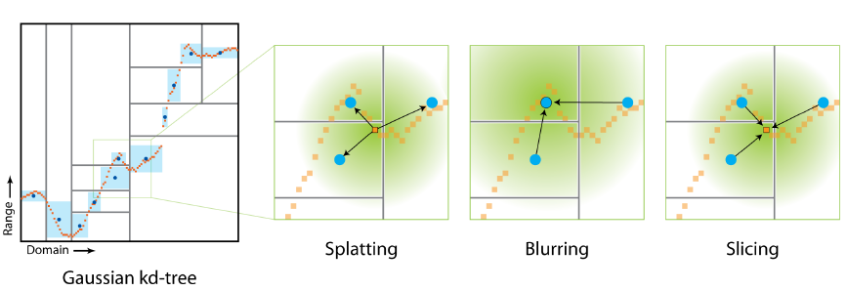
[Images from the author’s slide]

Slide 18
1-D Example of Splatting
η_{cut}
Space
η_{cut}
Querying
Position
Sample Distribution
Splatting
Splatting
Space
Querying
Position
[Images from the author’s slide]

Slide 19
1-D Example of Splatting
Space
η_{cut}
η_{cut}
Querying
Position
Sample Distribution
Splatting
Splatting
Space
Querying
Position
[Images from the author’s slide]

Slide 20
Correcting Weights for Splatting
pi
q
[Images from the author’s slide]

Slide 21
Blurring The Leaf Nodes

Slide 22
Slicing

Slide 23
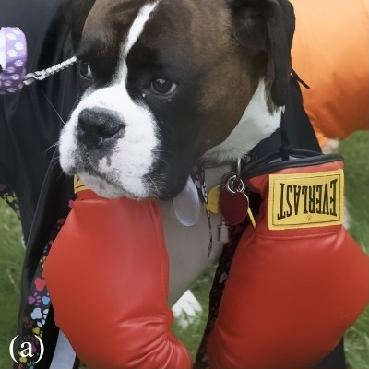

Results
Bilateral Filtering
Naïve Bilateral Filtering
5-D Bilateral Grid

Slide 24


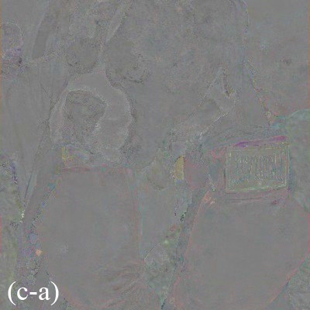
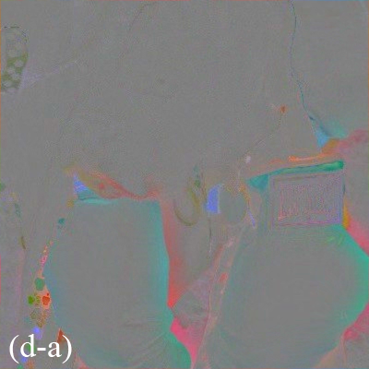
KD-Tree
3-D Bilateral Grid

Slide 25
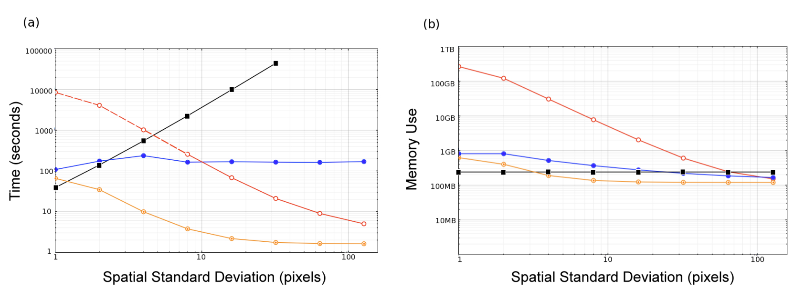

Complexity and Performance Analysis
O(dNlogN )
Filter Size
Large
5D Grid
Gaussian KD-Tree
Small
Naïve

Slide 26
Adaptive Manifolds for Real-Time High-Dimensional Filtering
Eduardo S. L. Gastal, Manuel M. Oliveira

Slide 27
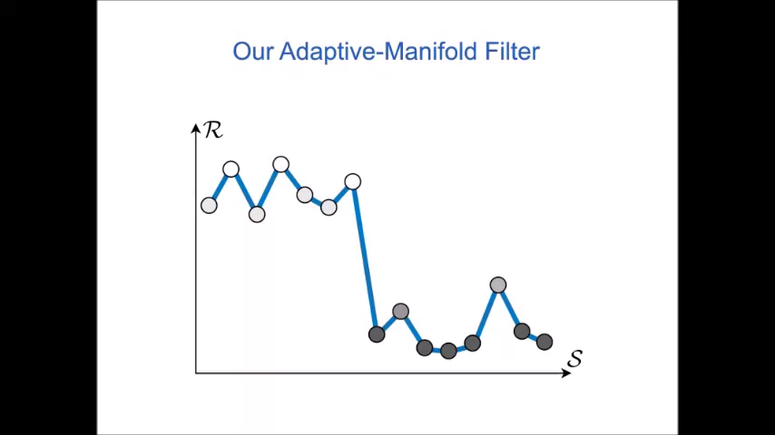
What is Manifold?

Slide 28
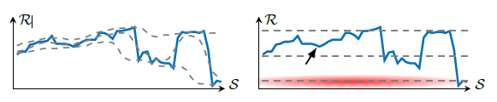
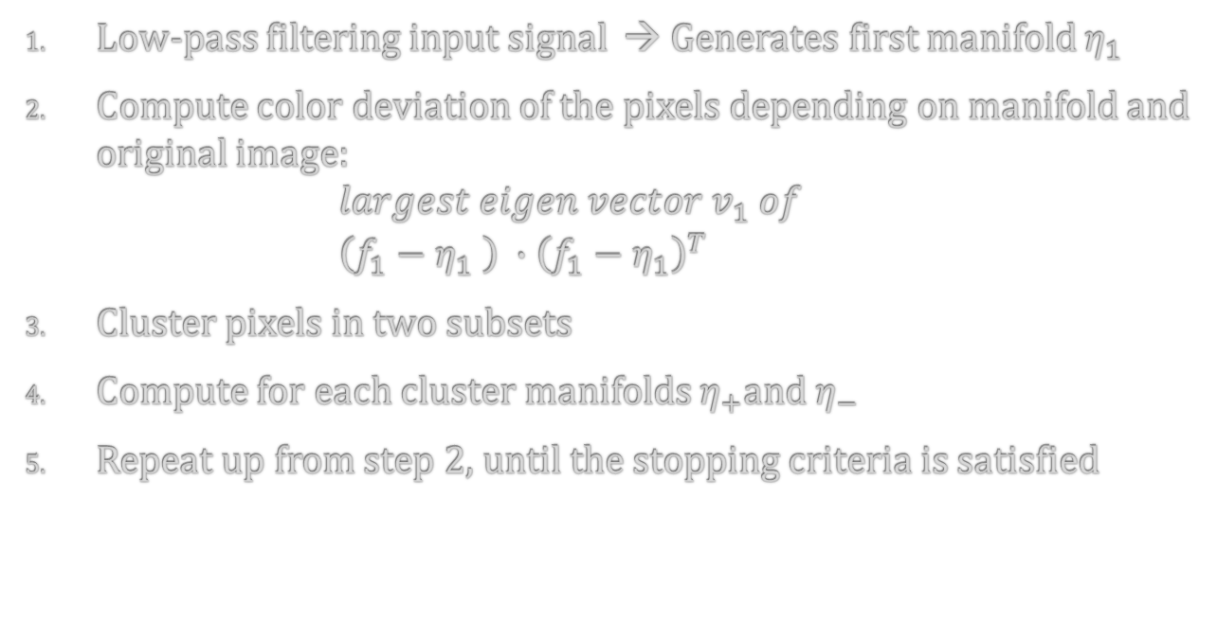
Constructing Manifolds
Low-pass filtering input signal → Generates first manifold $η_{1}$
Compute color deviation of the pixels depending on manifold and original image:
$largest eigen vector v_{1} of$
$\left(f_{1}−η_{1} \right) ∙{\left(f_{1}−η_{1}\right)}^{T}$
Cluster pixels in two subsets
Compute for each cluster manifolds $η_{+}$and $η_{−}$
Repeat up from step 2, until the stopping criteria is satisfied

Slide 29
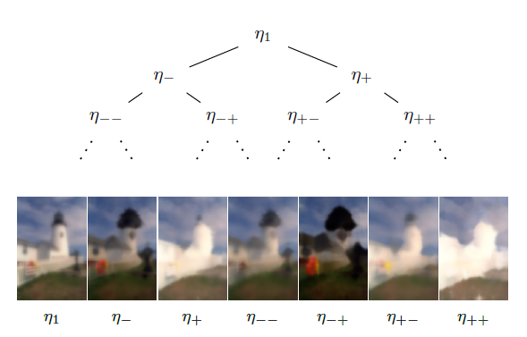
Constructing Manifolds

Slide 30
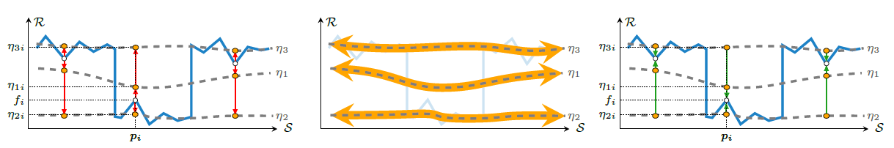
Algorithm
Splatting → Blurring → Slicing

Slide 31
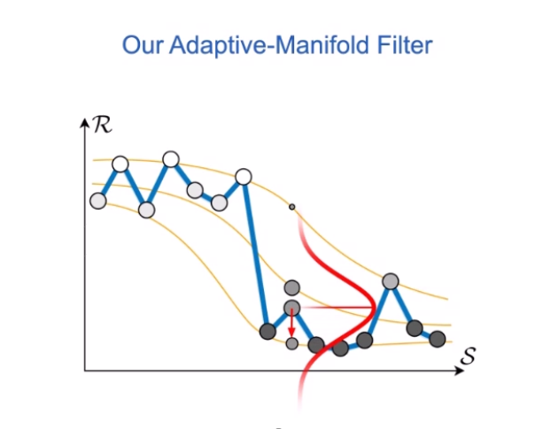
Algorithm - splatting
Projects Gaussian weighted color for each position onto each manifold

Slide 32
Algorithm – blurring
Blurs over all manifolds
Changes information between sample points

Slide 33
Algorithm - slicing
Compute filter response
Interpolates by blurred values over all adapted manifolds

Slide 34
Number of Manifolds
Independent of number of pixels and dimension
No general mechanism, sensitive to the problem
Depends of standard deviation of spatial- and range domain

Slide 35
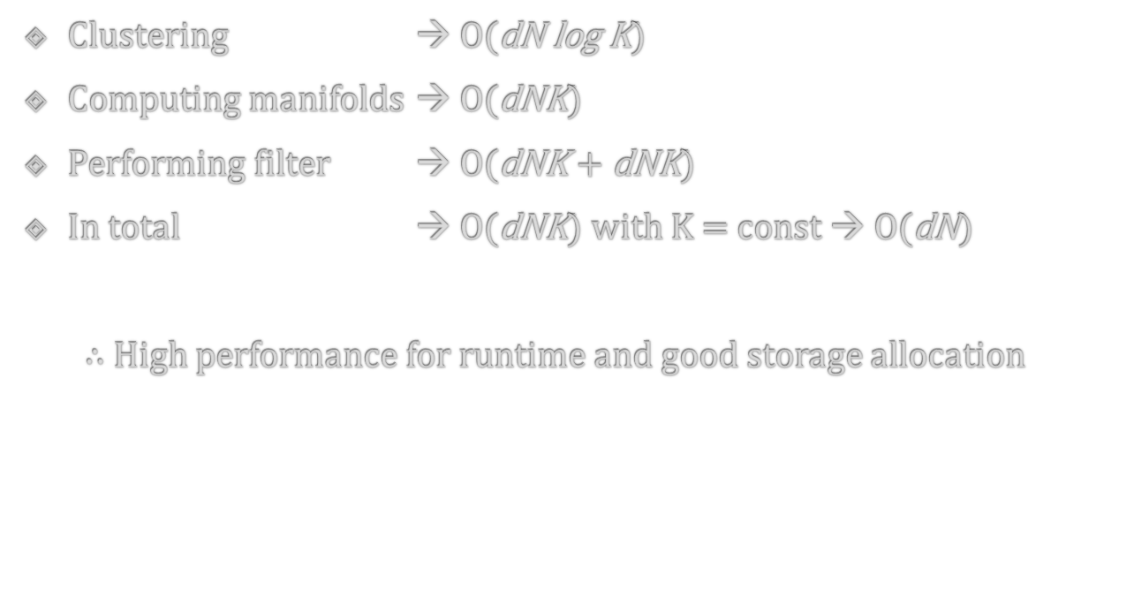
Analysis
Clustering → O(dN log K)
Computing manifolds → O(dNK)
Performing filter → O(dNK + dNK)
In total → O(dNK) with K = const → O(dN)
$∴$ High performance for runtime and good storage allocation

Slide 36
Summary
Advantages
  Adaptable for a "general framework"
  Runtime linear in number of pixels and dimension
  Euclidean and also geodesic filters adaptable
Drawbacks
  Sensitive to number of manifolds
  Choose of Gaussian kernels (standard deviation)

Slide 37
Thank you for your attention!

Slide 38
QUIZ
Which data structure is used in the first paper?
  Queue
  KD-tree
  Binary-tree
  Stack
What is the dimension of a black-and-white photograph?
  1-D
  2-D
  3-D
  5-D

